Slide 1
SMA & HULL TACTICAL Week 6

Slide 2
Today’s Outline
Outlier elimination
Changes to previous stationarity
Factor Importance Analysis
Coefficient Analysis with Ridge & Lasso
Principle Component Analysis
Explained Ratio
Principle Component Variance Ratio
Notes:
Main point of this week: feature filtering

Slide 3

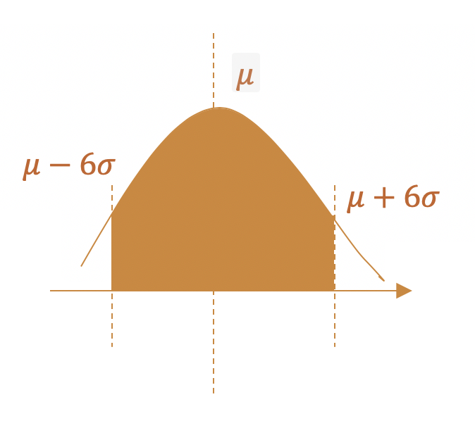
Outlier Elimination
1. Aggregate the daily data by take mean instead of sum.
2. Delete all the numbers out of 6 standard deviation.

Slide 4
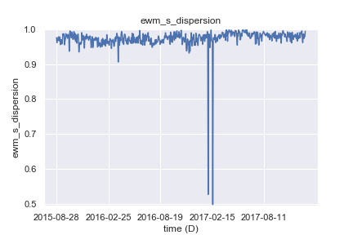
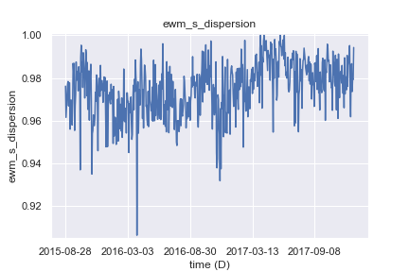
Change into Stationary
Previous
New
EMW_S_Dispersion
Notes:
Sentiment dispersion

Slide 5
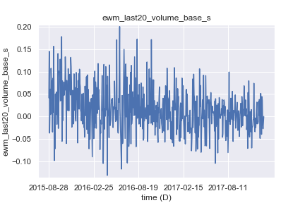
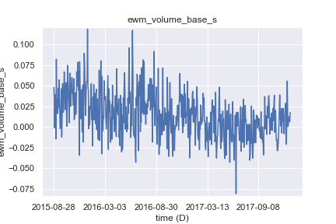
Change into Stationary
Previous
New
EMW_volume_base_S
Notes:
Sentient volumn

Slide 6
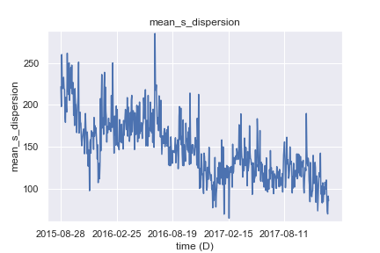
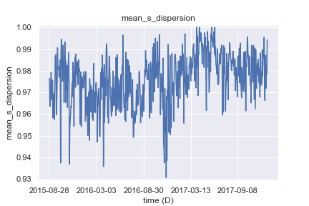
Change into Stationary
Previous
New
mean_s_dispersion
Notes:
Mean sentient dispersion, downward trend eliminated

Slide 7
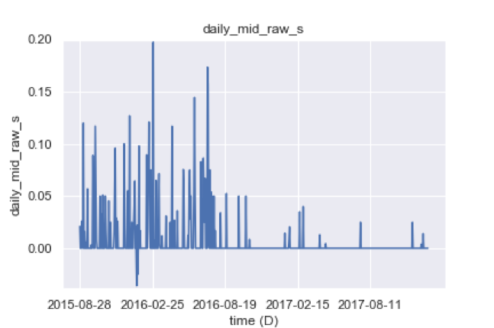
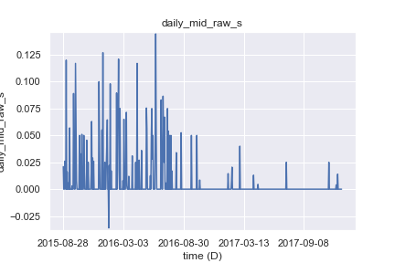
Change into Non-Stationary
Previous
New
daily_mid_raw_s
Notes:
Raw sentiment median daily

Slide 8
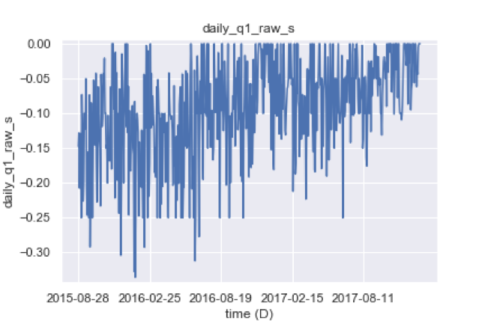
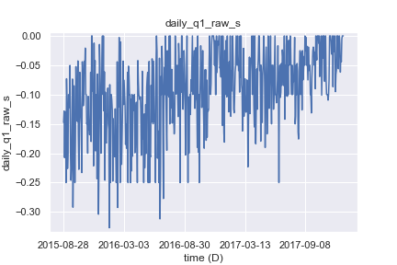
Change into Non-Stationary
Previous
New
daily_q1_raw_s
Notes:
Daily raw sentiment first quantile

Slide 9
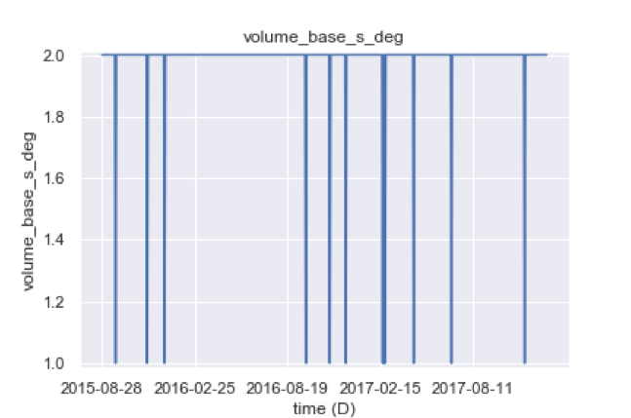
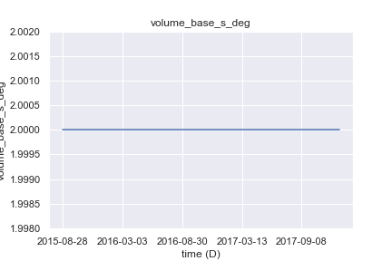
Change into Non-Stationary
Previous
New
volume_base_s_deg
Notes:
Wavelet analysis degree

Slide 10
Outlier Elimination
- Final Factors

Slide 11
Factor Importance Analysis
Ridge & Lasso Regression
Smoothing factor lambda
Tuning spacing of 1e-8
Accuracy Score
All stationary factors used to match next_return
Accuracy score is measured in R^2
Notes:
Lasso & ridge and its uses. We used lambda tuning to see the coefficient of all factors in both models.
A threshold for both models were used depending on their respective performance. Last 5 factors dropped out from the model.
When alpha increases, more penalty given to noisy factors and they get dropped out

Slide 12
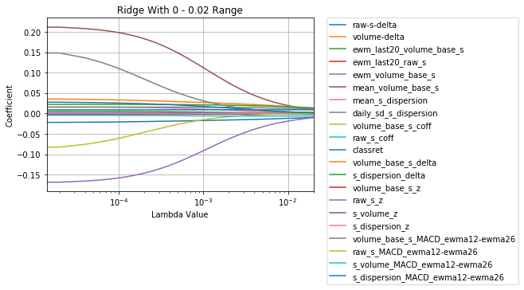
Ridge Regression
Ridge
Last 5 decayed below 1e-5:
raw_s_MACD
s_dispersion_delta
volume_base_s_delta
ewm_volume_base_s
mean_volume_base_s

Slide 13
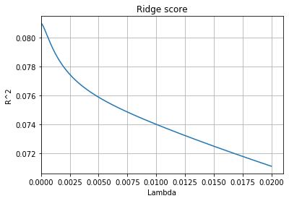
Ridge Regression
Max Score: 0.081
Notes:
Accuracy score very low, indicating linear regression not effective in prediction.
However does not affect usefulness of single factor. As long as noise filtered out, factor still useful with other models.

Slide 14
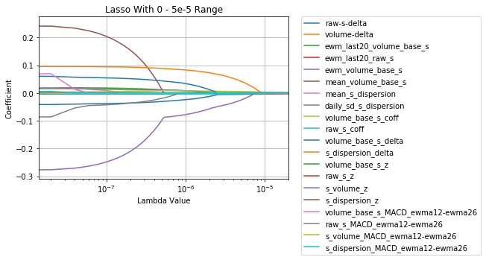
Lasso Regression
Lasso
Last 5 decayed to 0:
volume_base_s_z
raw_s_z
s_dispersion_z
raw_s_coff
ewm_last20_raw_s

Slide 15
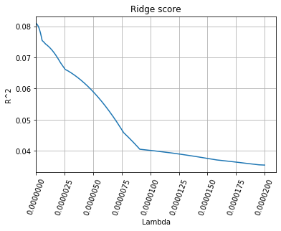
Ridge Regression
Max Score: 0.081

Slide 16
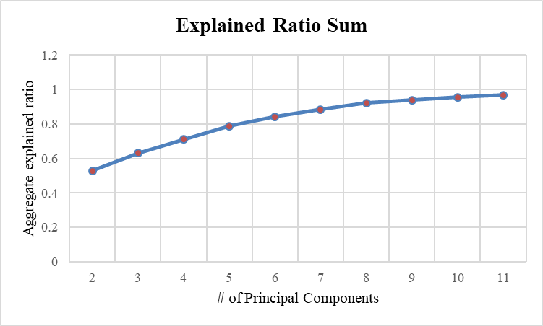
Principle Component Analysis
- Principle Components Explained Ratio

Slide 17
Principle Component Analysis
- Principle Components Explained Ratio
Notes:
PCA is orthorgonal transformation of each factor

Slide 18
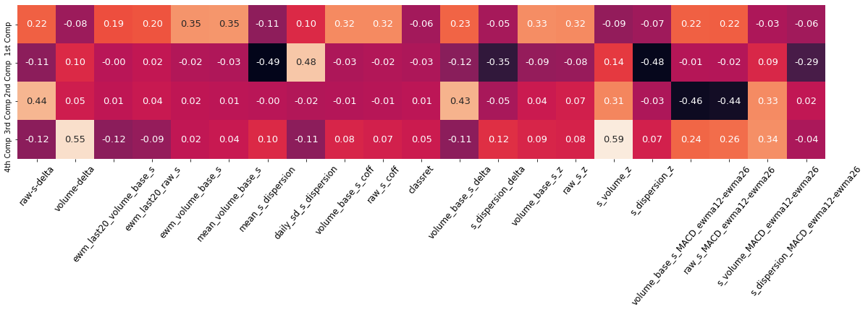




Principle Component Analysis
- Principle Components Variance Ratio
Notes:
Effective ones with higher coefficients.

Slide 19
Thank you!
Notes:
PCA is orthorgonal transformation of each factor

